Slide 1
Domain Identification in Proteins
Problem Statement: To develop an automated method to identify all the domains in a protein.
Advancements up until now.
Thus, there are two sub problems which are to be solved:
    Identify the number of domains.
    Identify the domain boundaries.

Slide 2
Identifying Domain Boundaries
Compared various clustering algorithms.
Contiguous Multi-Domain Proteins
Non-Contiguous Multi-Domain Proteins
Clustering Technique | K-Means | Birch | Mean Shift | Agglomerative | DBSCAN
Average Overlap | 82.01% | 76.38% | 47.12% | 79.36% | 37.04%
Clustering Technique | K-Means | Birch | Mean Shift | Agglomerative | DBSCAN
Average Overlap | 81.47% | 73.97% | 39.53% | 73.97% | 36.92%

Slide 3
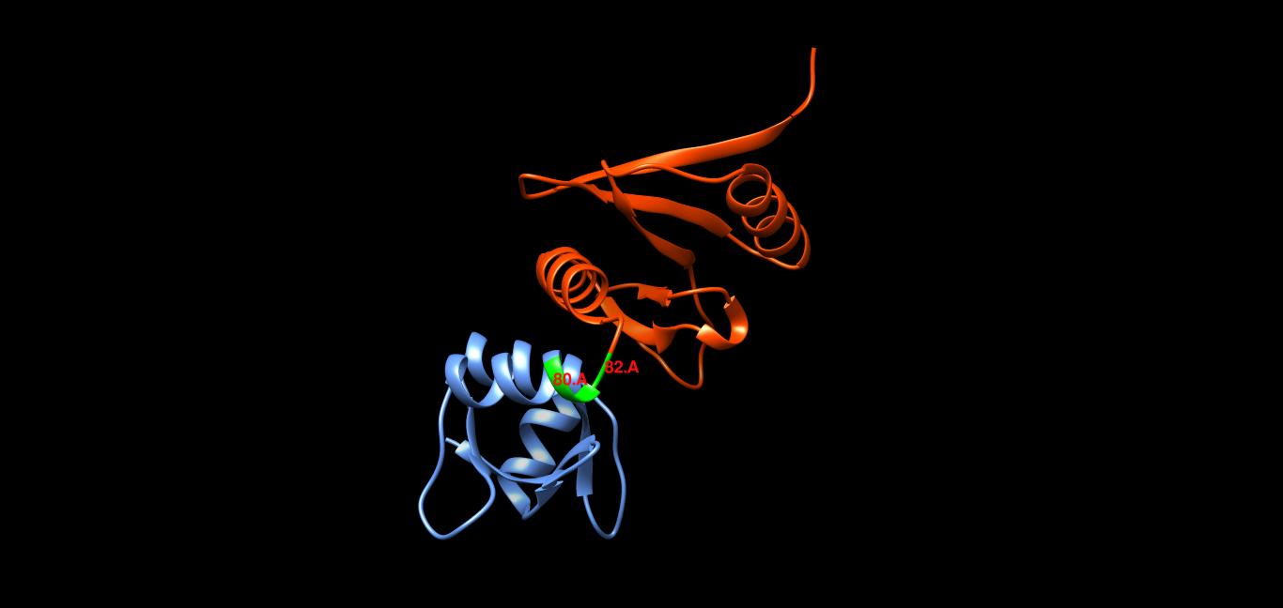
Problems with K-Means
1. Incorrect Boundary prediction

Slide 4
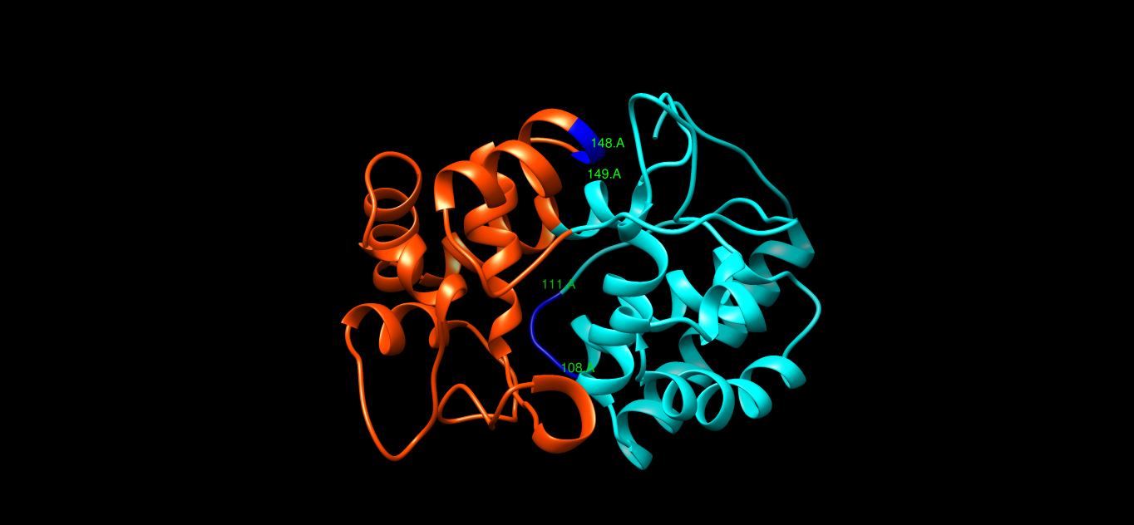
2. Mismatched residues
3. It requires K(the number of clusters) as an input

Slide 5
Finding The Number Of Domains
Tried to establish a correlation of the number of domains with the following attributes of a protein:
Length
Radius of Gyration
Interaction Energy

